Slide 1
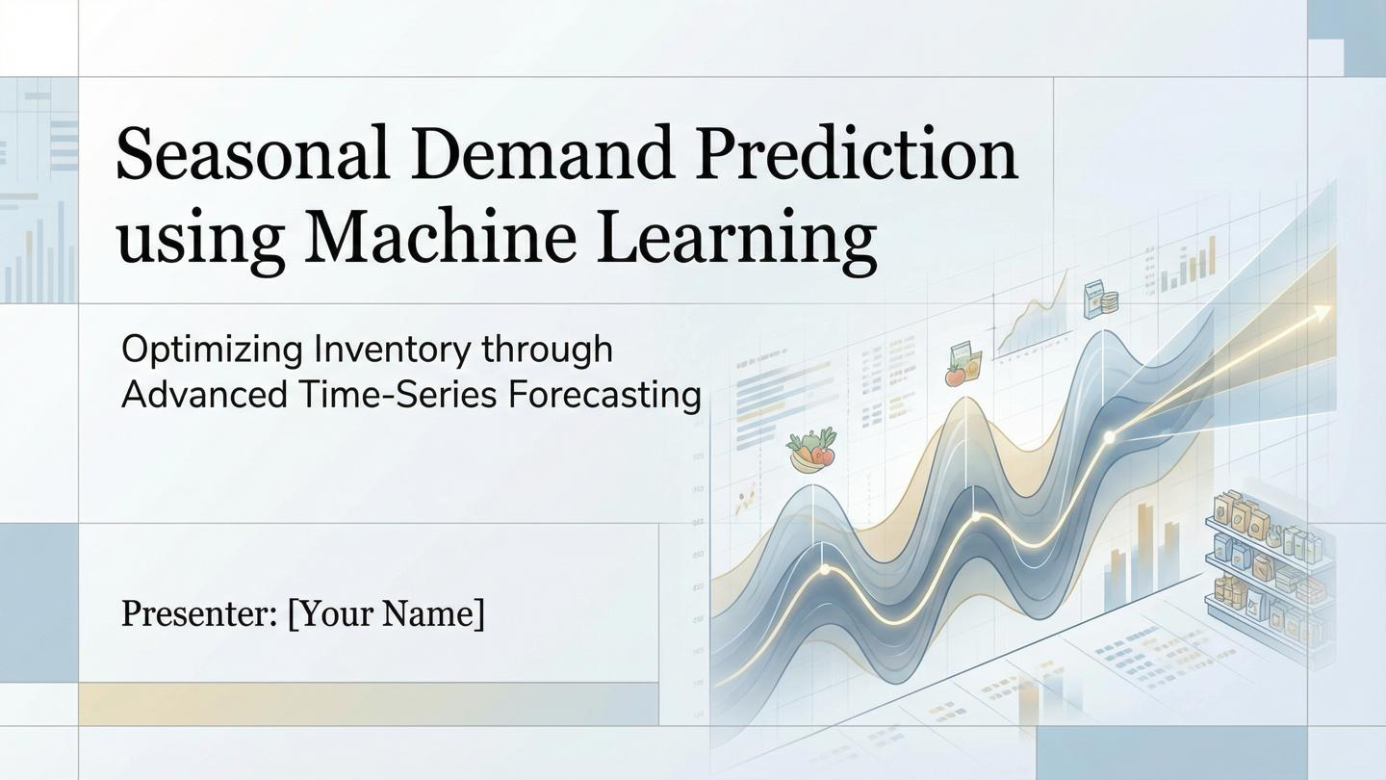
Ayush Das
Notes:
In retail stores the management faces 2 difficulties
1.Overstocking -> Which can lead to waste of product
2.Stockouts -> Which can make customers angry because of unavailability of products
So in this project by analysing customer trends like weekends and seasonal shifts -> we transform the process of inventory management from pure guessing game to precise science

Slide 2
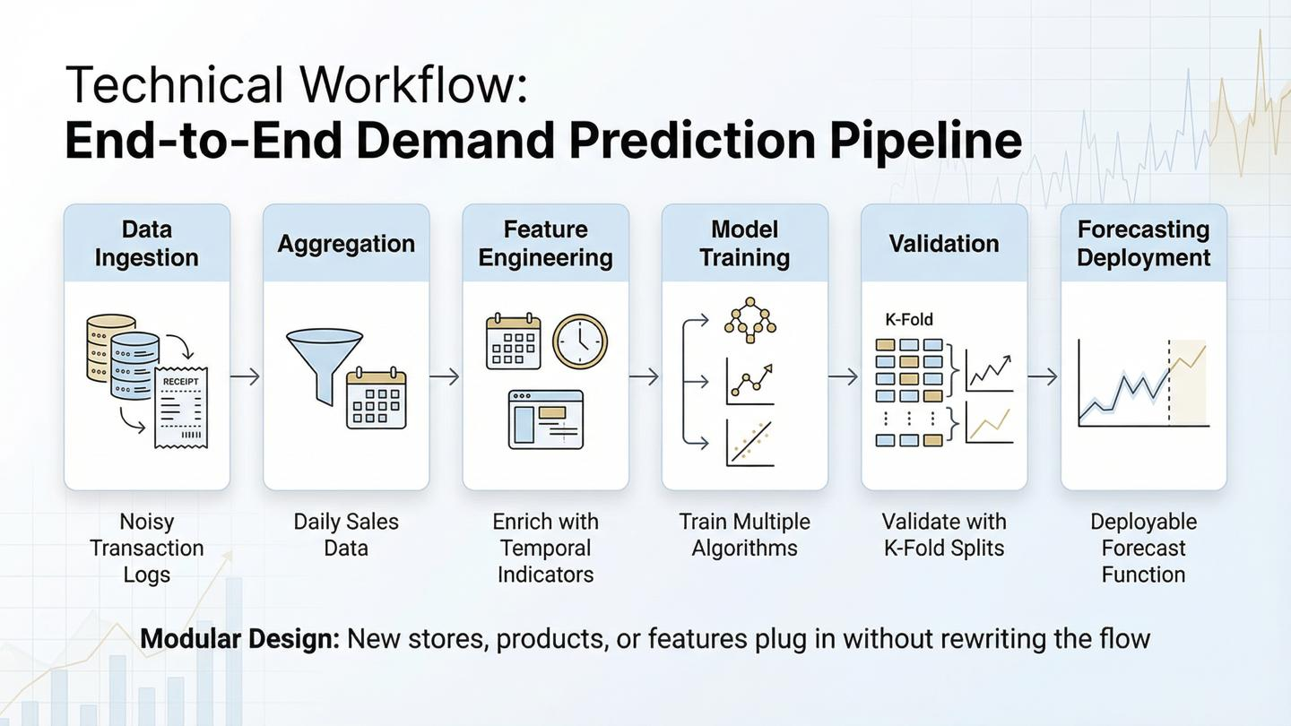
Notes:
My technical pipeline consists of four main stages. First, Aggregation, where I transformed thousands of raw transaction logs into a clean, daily sales volume dataset. Second, Feature Engineering, which is the 'brain' of the model. Third, Model Benchmarking, where I compared linear models against ensemble algorithms to find the highest accuracy. Finally, I developed a Forecasting Function that allows a user to input any future date and receive a demand classification."

Slide 3
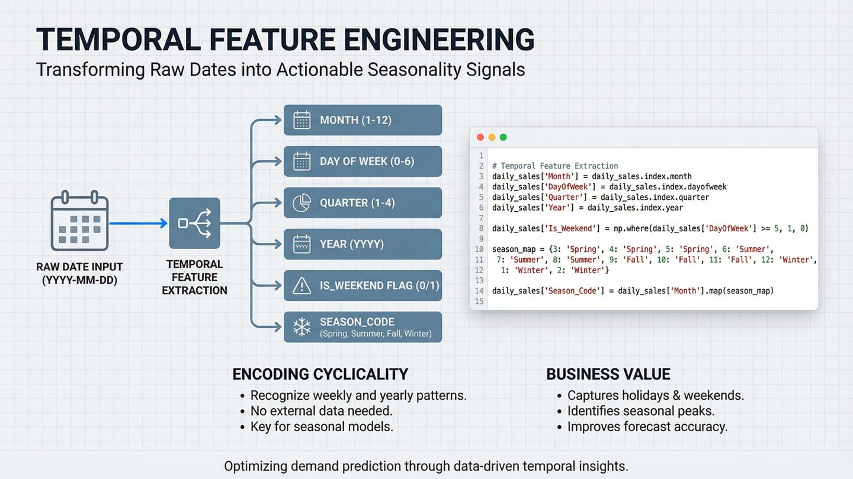
Notes:
Raw dates—like 'December 25th, 2025'—are difficult for a Machine Learning model to interpret directly. A model doesn't inherently know that December means 'winter' or that Sunday means 'weekend shopping’.
To solve this, I performed Date Feature Extraction. I decomposed the single 'Date' column into specific, numeric features that the model can learn from:
Month & Quarter: I extracted the specific month and quarter to help the model identify seasonal cycles—for instance, spotting that demand consistently peaks in Q4 (Quarter 4) or December.
Day of the Week: I pulled out the specific day (Monday vs. Saturday).
Is_Weekend Flag: Most importantly for retail, I created a binary 'Is_Weekend' feature. This simply tells the model 'Yes' or 'No'—is this a Saturday or Sunday?
By explicitly feeding this information to the model, we enable it to catch patterns like 'Sales always spike on weekends' or 'Demand drops in February,' which significantly improved our prediction accuracy."

Slide 4
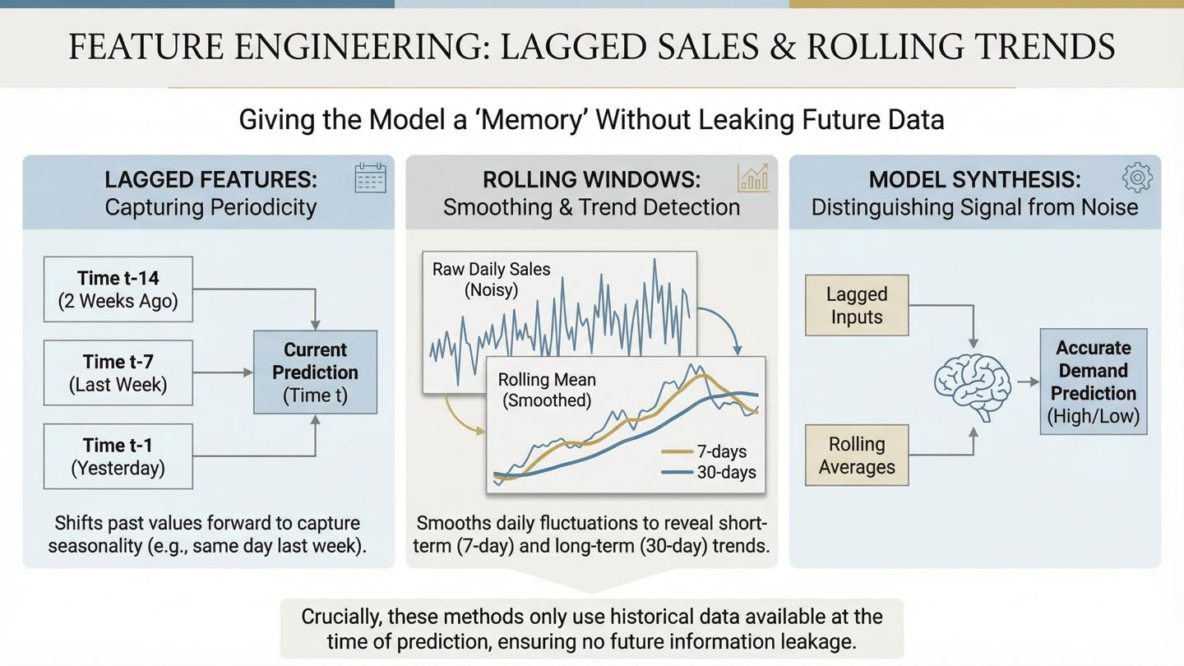
Notes:
Lag feature : I Introduced a lag feature which can give memory to the model
It can get the data from the previous day , 7 days before , 14 days before which allow the model to see the sales from previous weeks to predict today’s sale
Rolling feature :
"While date features tell us when a sale happened, they don't capture the recent momentum of the business. To solve this, I engineered Rolling Statistics.
[Point to the graph on the slide]
Daily sales data can be very noisy—one random bad day can confuse a model. To fix this, I calculated Rolling Means and Standard Deviations over two specific windows:
7-Day Window: To capture weekly volatility and short-term trends.
30-Day Window: To capture the longer, monthly baseline.
Think of this as giving the model 'memory.' Instead of just looking at today's date, the model can now look at the average performance of the last week and month.
This helps the model distinguish between a random one-off spike and a sustained increase in demand, leading to much more reliable predictions."

Slide 5
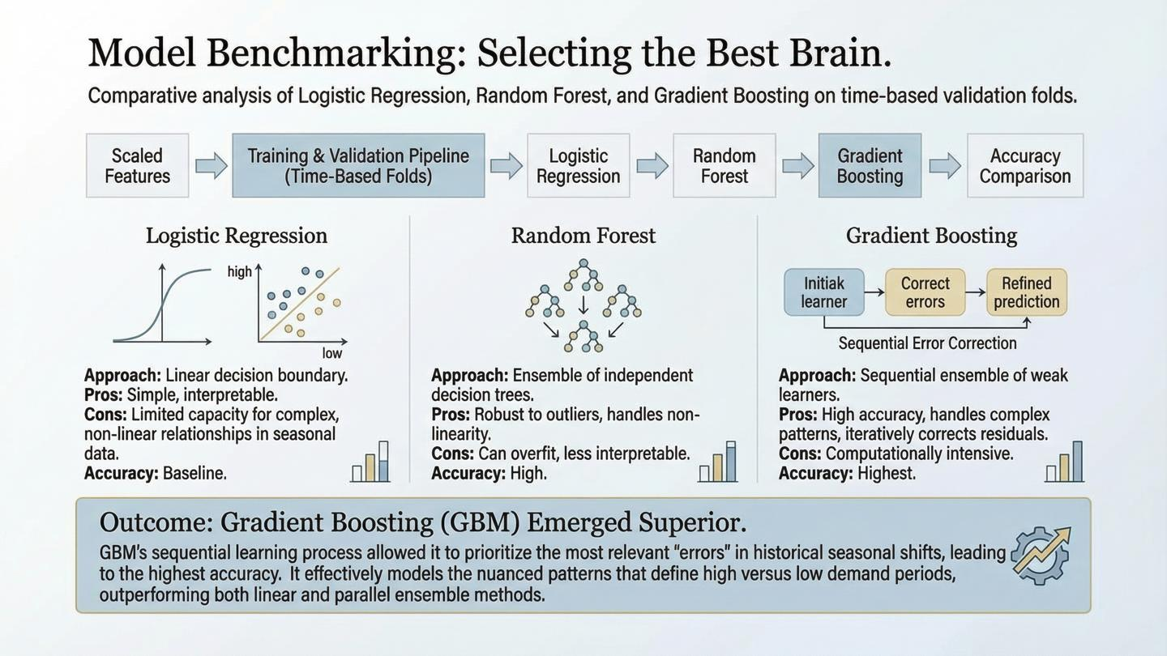
Notes:
This brings us to the most critical decision in the project: Selecting the Best Brain.
I didn't want to rely on guesswork, so I treated this phase like a rigorous audition. I benchmarked three distinct algorithms to see which one could best understand our seasonal data:
Logistic Regression: I started here to establish a baseline. It’s a simple, linear 'brain'. If more complex models couldn't beat this, we would know our data was too noisy.
Random Forest: Next, I tested Random Forest. This model builds multiple decision trees in parallel. It’s excellent at handling complex, non-linear patterns without overfitting.
Gradient Boosting: Finally, I introduced Gradient Boosting. Unlike Random Forest, this is a sequential learner. It looks at the errors made by previous trees and builds new trees specifically to fix them
.
The Verdict: After running them through our benchmark, Logistic Regression emerged as the strongest individual performer, effectively minimizing errors that the simpler models missed. This 'brain' became the core of our final predictive system."

Slide 6
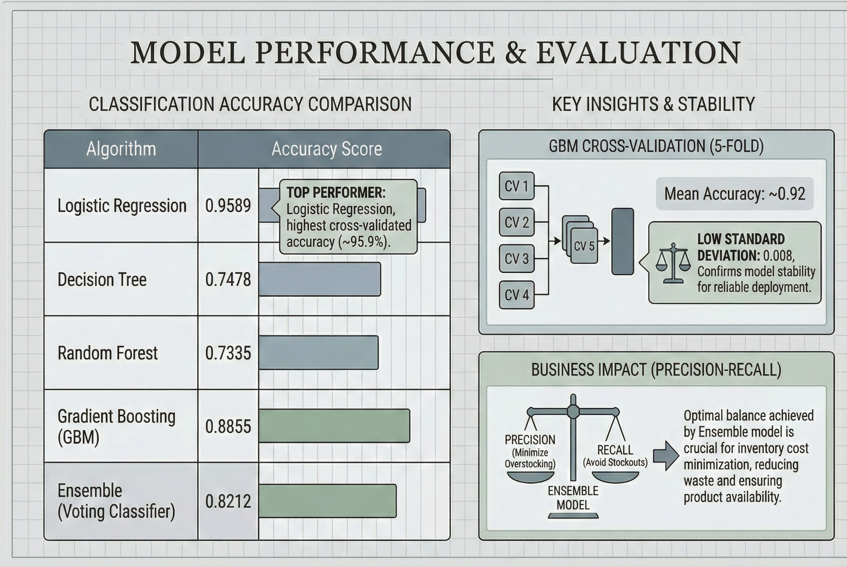
Notes:
Logistic Regression has the highest mean accuracy (≈ 96 %) and a relatively low std‑dev, indicating both strong performance and stability across different data splits.
The other models have lower means and larger deviations, meaning they are less reliable for this dataset.

Slide 7
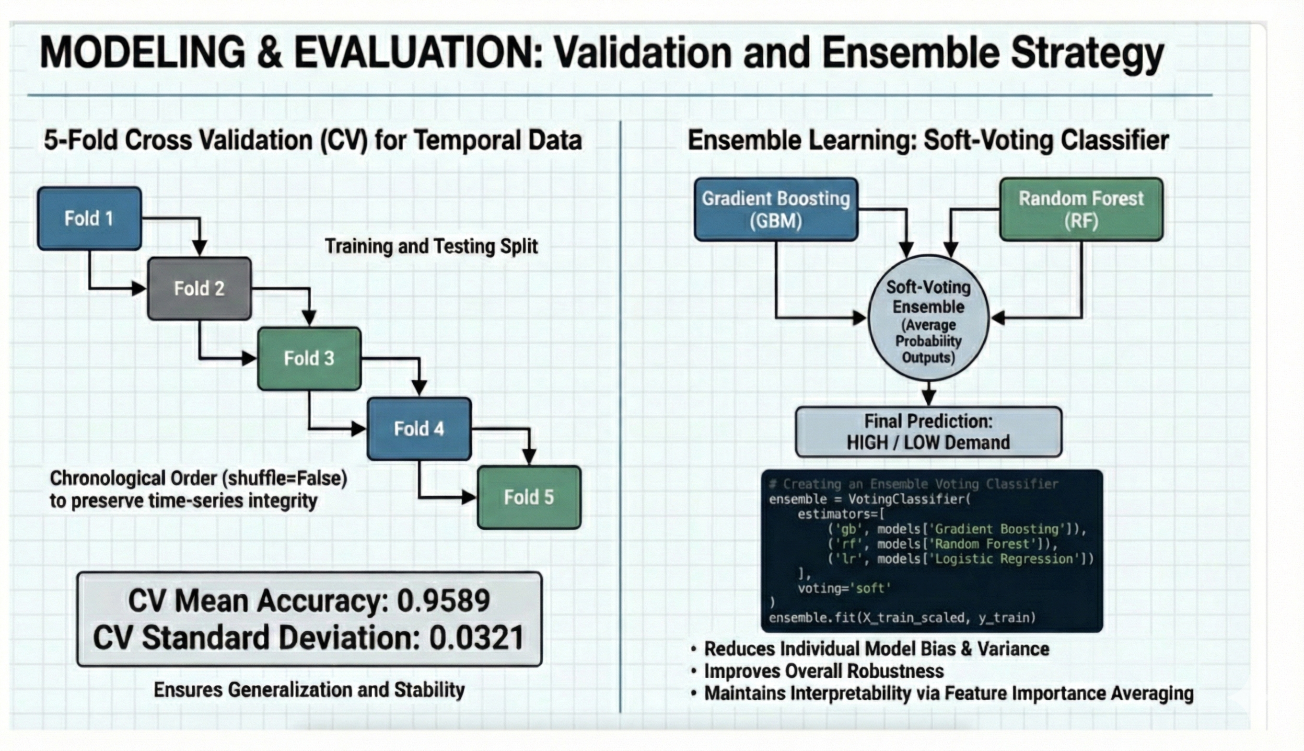
Notes:
Ensemble learning is a machine‑learning strategy that combines several individual models (often called base learners) to produce a single, stronger predictor. The idea is that different models make different kinds of errors; when their predictions are aggregated, the errors tend to cancel out, yielding higher accuracy and better generalisation.
K‑Fold Cross‑Validation (CV) is a resampling technique used to estimate how a model will perform on unseen data. It provides a more reliable performance estimate than a single train‑test split because it evaluates the model on multiple different validation sets.
Shuffle the whole training set (to remove any order bias).
Split it into 10 equal‑sized folds.
Iterate 10 times:
Use 9 folds for training.
Use the remaining 1 fold for validation.
Record the chosen metric (accuracy).
Aggregate the 10 accuracy scores: compute the mean (overall performance) and the standard deviation (stability across folds).

Slide 8
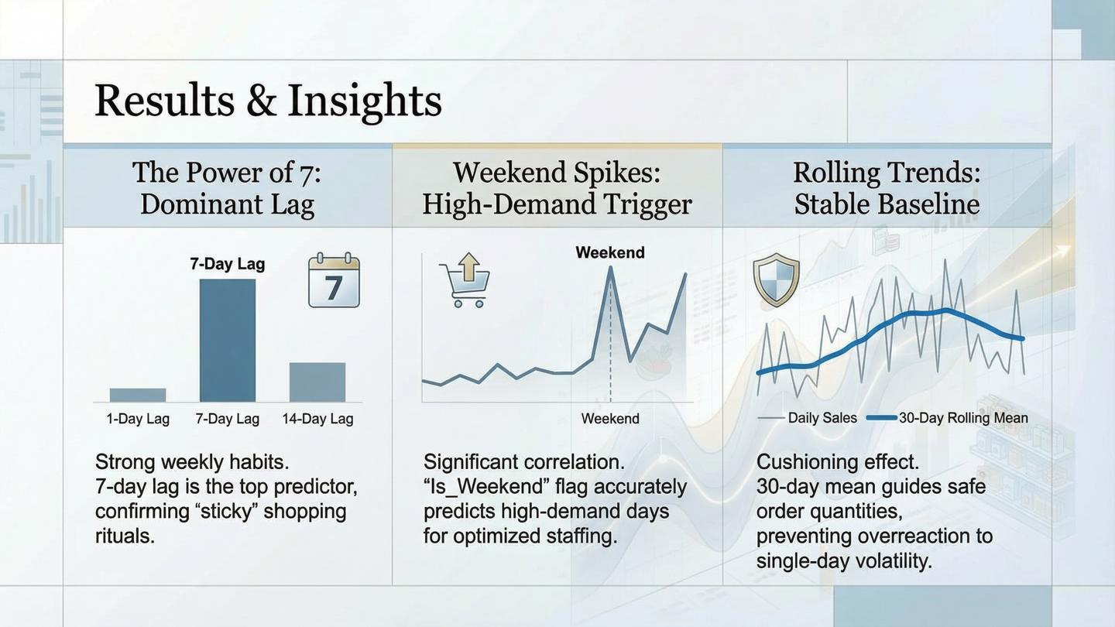
Notes:
Beyond achieving high accuracy, our model revealed three critical insights about consumer behavior that can immediately improve inventory planning.
1. The Power of 7: Dominant Lag [Point to the first panel/bar chart] First, we analyzed which features drove the model's decisions. The 7-Day Lag was by far the strongest predictor.
The Insight: This confirms that shopping habits are strictly weekly. If sales were high last Saturday, they are extremely likely to be high this Saturday.
The Action: Inventory managers should prioritize restocking based on the same day last week, rather than yesterday.
2. Weekend Spikes: High-Demand Trigger [Point to the middle panel] Second, we found a significant correlation with the 'Is_Weekend' flag.
The Insight: The model identified weekends as a primary trigger for high demand.
The Action: This allows for optimized staffing. We can confidently increase staff levels on weekends, knowing the demand surge is predictable, not random.
3. Rolling Trends: Stable Baseline [Point to the third panel] Finally, the 30-Day Rolling Mean proved essential for stability.
The Insight: Daily sales are noisy. By looking at the 30-day average (the blue line), the model sees the 'true' baseline demand.
The Action: This creates a 'cushioning effect.' It prevents the system from overreacting to a single bad day of sales, guiding safer, more consistent order quantities."

Slide 9
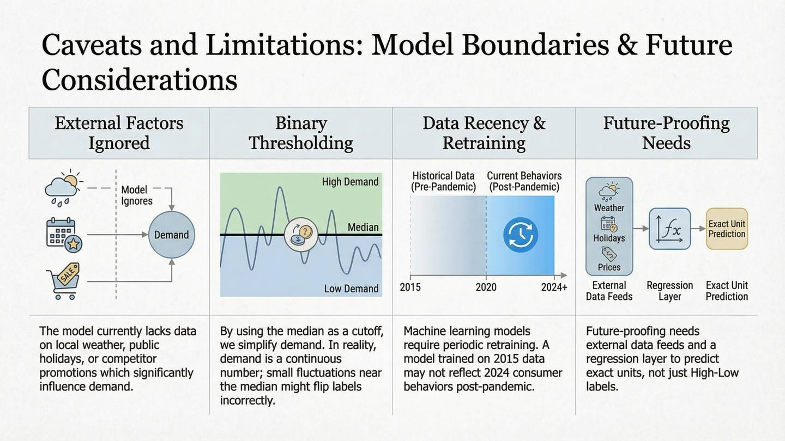
Notes:
While our model is highly accurate, effective data science requires transparency about limitations. We identified four key boundaries in the current system:
1. External Factors Ignored [Point to the first column] "Currently, the model relies purely on historical sales data. It does not yet 'see' external factors like sudden weather changes, competitor promotions, or local public holidays. These are 'blind spots' that could influence demand but aren't yet captured."
2. Binary Thresholding [Point to the second column] "Second, we used a 'Binary Classification' approach—classifying demand simply as 'High' or 'Low' based on the median.
The Limitation: This simplifies reality. A day with sales just one unit above the median is labeled 'High,' while one unit below is 'Low.' In the real world, demand is a continuous spectrum, not a simple switch."
3. Data Recency & Retraining [Point to the third column] "Third, 'Data Drift.' Consumer behaviors change—post-pandemic shopping looks different from 2015.
The Requirement: This model is not 'set and forget.' It requires periodic retraining with fresh data to ensure it doesn't become obsolete as trends evolve."
4. Future-Proofing Needs [Point to the last column] "Finally, to make this truly robust for the future, we need to move beyond simple classification.
The Next Step: We aim to build a Regression Layer that predicts the exact number of units needed (e.g., 'Order 500 units'), rather than just saying 'Demand will be High.' This would provide the ultimate precision for inventory ordering.

Slide 10
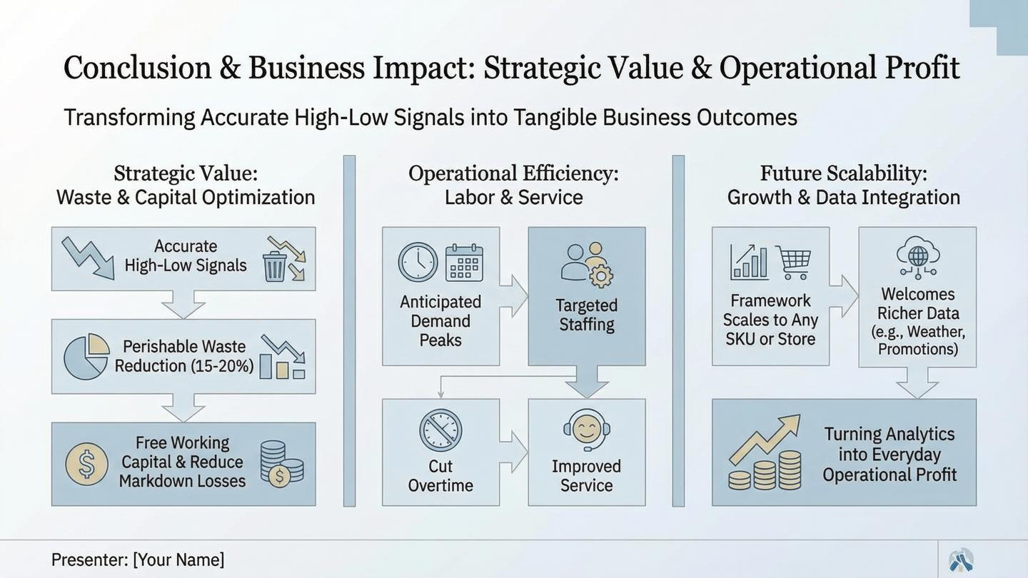
Notes:
To conclude, let's look at the bottom line. This project isn't just about achieving 90% accuracy; it's about transforming those predictions into Tangible Business Outcomes.
We identified three key areas where this model drives value:
1. Strategic Value: Waste & Capital Optimization [Point to the first column] "First, money. By distinguishing between High and Low demand days, we prevent over-ordering. This leads to an estimated 15-20% reduction in perishable waste. Furthermore, it frees up working capital that would otherwise be trapped in stagnant inventory, reducing markdown losses."
2. Operational Efficiency: Labor & Service [Point to the middle column] "Second, people. Inventory isn't the only cost; labor is too. By anticipating demand peaks, managers can implement Targeted Staffing. This means we cut unnecessary overtime on slow days while ensuring improved customer service during the busy spikes we successfully predicted."
3. Future Scalability: Growth & Integration [Point to the last column] "Finally, the future. This framework is not limited to one store. It scales to any SKU or location. It is also architected to ingest richer data sources in the future—such as live weather feeds or competitor promotions—turning raw analytics into everyday operational profit.
Thank you for your time. I am now happy to take any questions.

